Slide 1
My Closet
Designed by:
Lilu odedra (1896615)
Shivdeep kaur (1896567)
Krishna naik (189….)
Urvi arora (189….)
Anuj monga (189….)

Slide 2
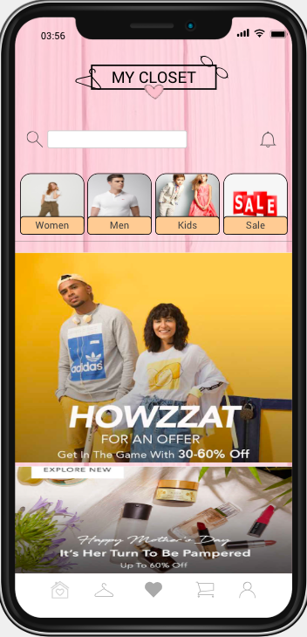
Main page
Our first page is the main page
Categories:
Men
Women
Kids
Sales
Components:
Shapes
Images
Ios icons

Slide 3
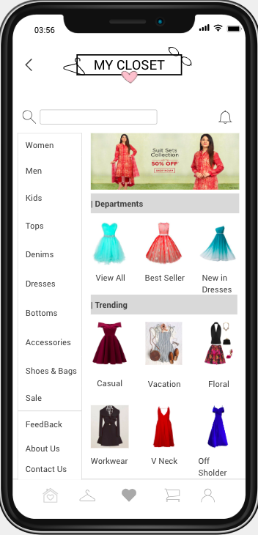
Category Page
Navigation
Main page -->Category
You can find different types of categories as per your choice.
Components :
Images
Table
Textbox
Ios icons

Slide 4
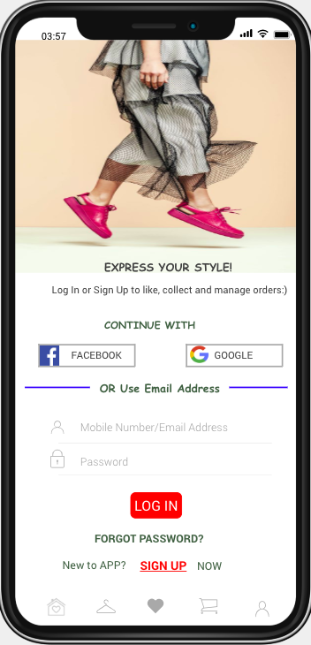
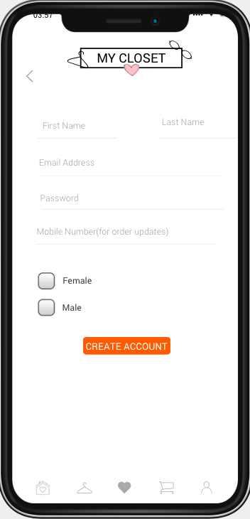
Sign in and Sign up page
Navigation
Main page →sign in→ Sign up
Registered users can sign in through this
page and if not registered then they must go to the sign up page.
Components:
Images
Button
Input text
Textbox
Ios icons
Links
Checkboxes

Slide 5
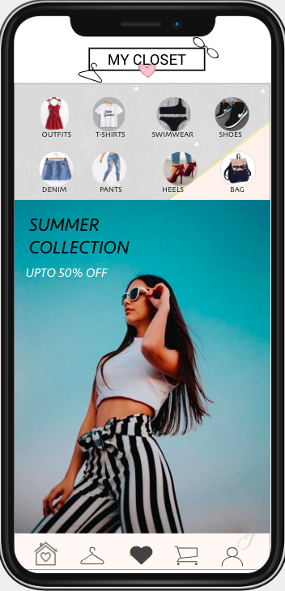
Women main page
Navigation
Main page →women main page
You can find different categories of women clothes and sales,
Discounts on different brands.
Components :
Images
Textbox
Ios icons
Links
Dynamic panel
YOU CAN FIND THE SAME NAVIGATION FOR MEN AND KIDS.

Slide 6
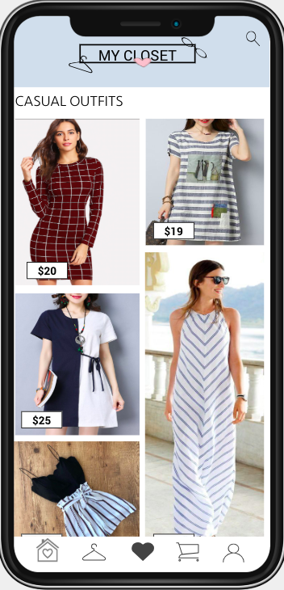
Casual outfit page
Navigation
Main page →women main page→casual oufits
You can find different types of casual outfits.
Components:
Images
Textbox
Ios icons
Links
Dynamic panel

Slide 7
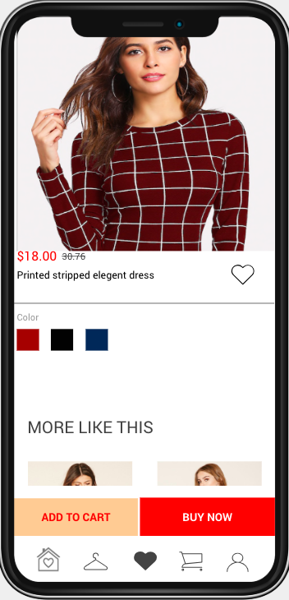
Outfit description page
Navigation
Main page →women main page→casual oufits→outfit
description page.
You can find different types of casua outfitsl.
Components:
Images
Textbox
Ios icons
button
Links
Dynamic panel
Vertical and horizontal scrolling

Slide 8
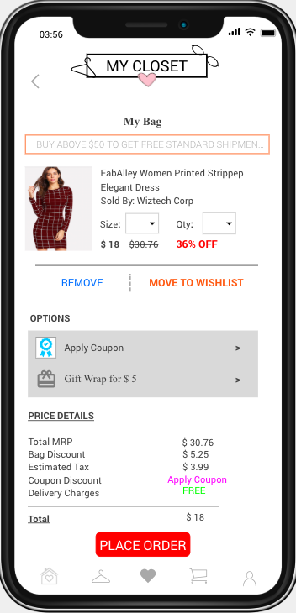
Place order page
Navigation
Outfit description page→order page→place order.
Description:
You can place order for a particular item and can adjust quantity.
Components used:
Images
Textbox
Ios icons
button
Links
Dropdown menu

Slide 9
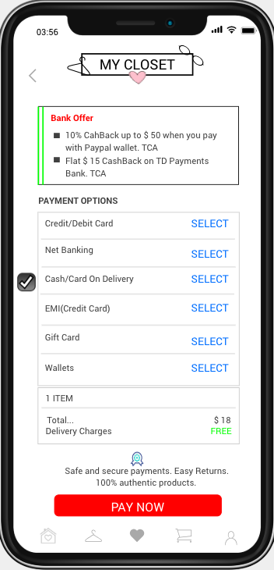
Payment page
Navigation
Outfit description page→order page→place order.
Description→Payment page
Here you can select the payment option as per your choice.
Components:
Images
Textbox
Ios icons
Button
checkbox
Links

Slide 10
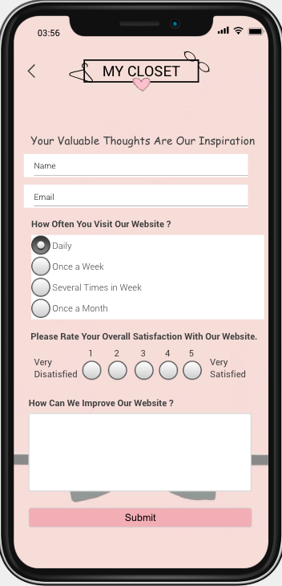
Feedback page
Navigation:
Category→ Feedback
Description:
You can give your feedback about services.
Components:
Images
Textbox
Ios icons
Button
Radio button
Links

Slide 11
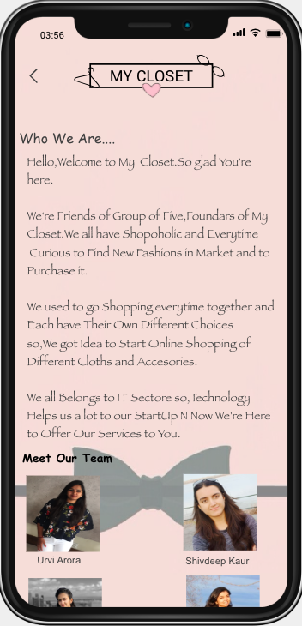
About us page
Navigation:Category→ About us page
Description:
You can find information about the people who have developed
this app
Components:
Images
Textbox
Ios icons
Dynamic panel
Vertical scrolling
Button
Radio button
Links

Slide 12
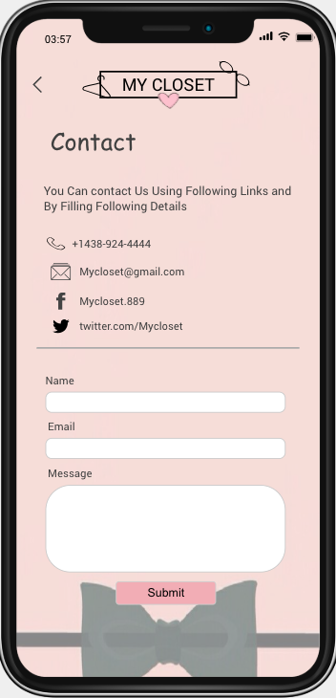
Contact us page
Navigation:Category→ Contact us page
Description:
Here you can find some links to communicate with the owner as
well as you can fill out the details and sent it to them.
Components:
Images
Textbox
Ios icons
Dynamin panel
Button
Radio button
Links

Slide 13
THANK YOU…!!!

